Slide 1
Chapter 10: Forecasting Techniques
Business Analytics: Methods, Models, and Decisions, 1st edition
James R. Evans

Slide 2
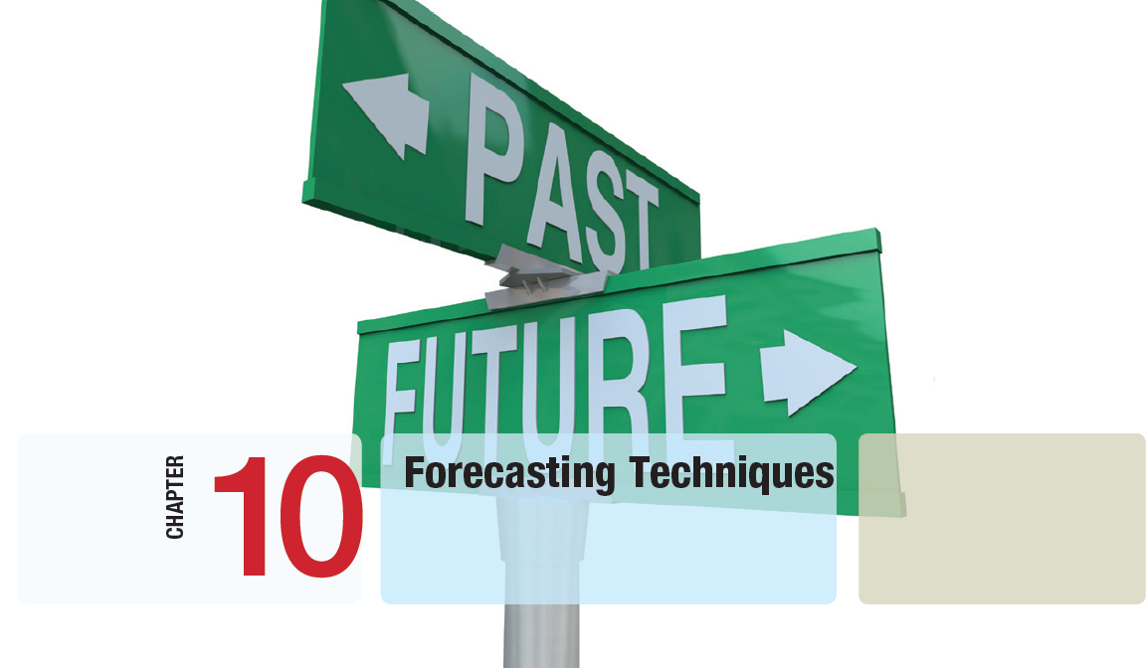

Slide 3
Chapter 10 Topics
Forecasting Techniques
Qualitative and Judgmental Forecasting
Statistical Forecasting Models
Forecasting Models for Time Series with a Linear Trend
Forecasting Time Series with Seasonality
Selecting Appropriate Time-Series-Based Forecasting Methods
Regression Forecasting with Causal Variables
The Practice of Forecasting

Slide 4
Forecasting Techniques
Managers require good forecasts of future event.
Business Analysts may choose from a wide range of forecasting techniques to support decision making.
Three major categories of forecasting approaches:
1. Qualitative and judgmental techniques
2. Statistical time-series models
3. Explanatory/causal models

Slide 5
Qualitative and Judgmental Forecasting
Qualitative and Judgmental techniques rely on experience and intuition.
They are necessary when historical data is not available or when predictions are needed far into the future.
The historical analogy approach obtains a forecast through comparative analysis with prior situations.
The Delphi method questions an anonymous panel of experts 2-3 times in order to reach a convergence of opinion on the forecasted variable.
Indicators and indexes are measures believed to influence the variable we wish to forecast.

Slide 6
Qualitative and Judgmental Forecasting
Example 10.1 Predicting the Price of Oil
Early 1988 – oil price was about $22 a barrel
Mid-1988 – oil price dropped to $11 a barrel
Price decrease due to oversupply/lower demand
OPEC eventually reduced supply
In 2000 – price rose to $27
Late 2001 – price dropped to $23
Forecasting the price of oil requires judgment.

Slide 7
Qualitative and Judgmental Forecasting
Example 10.2 Economic Indicators
GDP (Gross Domestic Product) measures the value of all goods and services produced.
GDP rises and falls in a cyclic fashion.
Forecasting GDP is often done using leading and lagging indicators, for example:
Leading - formation of business enterprises
- percent change in money supply (M1)
Lagging - business investment expenditures
- prime rate
- inventories on hand

Slide 8
Qualitative and Judgmental Forecasting
Example 10.3 Leading Economic Indicators
An Index of Leading Indicators was developed by the Department of Commerce.
This index (a combination of indicators) is related to the economic performance is available from www.conference-board.org.
It includes measures such as:
- average weekly manufacturing hours
- new orders for consumer goods
- building permits for private housing
- S&P 500 stock prices

Slide 9
Statistical Forecasting Models
Time Series
A stream of historical data, such as weekly sales
T = number of periods, t = 1, 2, …, T
Time series generally have components such as:
- random behavior
- trends (upward or downward)
- seasonal effects
- cyclical effects
Stationary time series have only random behavior.

Slide 10
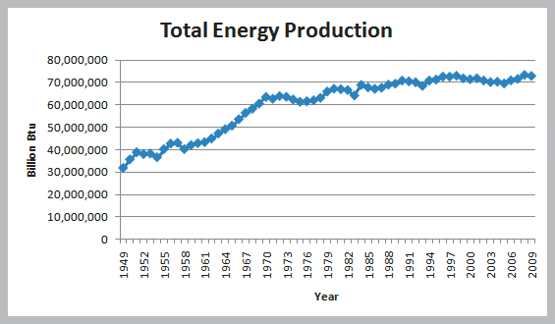
Statistical Forecasting Models
Example 10.4 Identifying Trends in a Time Series
The Energy and Production data reveals an increasing trend of about 500,000 billion btu/year.
Figure 10.1

Slide 11
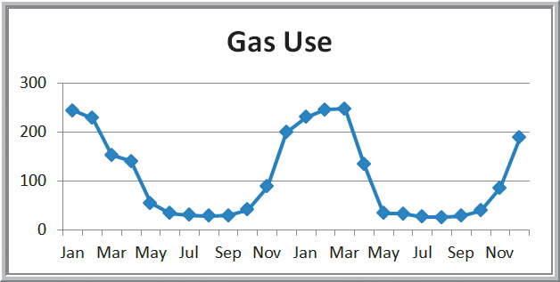
Statistical Forecasting Models
Seasonal Effects in Natural Gas Usage
The Gas & Electric data reveals a seasonal pattern of high winter time usage of natural gas.
Figure 10.2

Slide 12
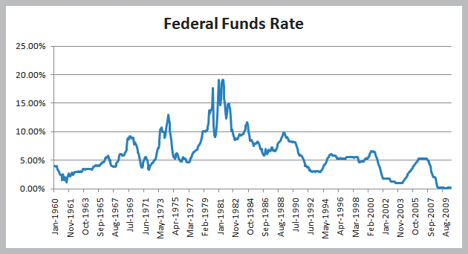
Statistical Forecasting Models
Cyclical Effects in Federal Funds Rates Usage
The Federal Funds Rate data reveals long-term cycles that are driven by economic factors.
Figure 10.3

Slide 13
Statistical Forecasting Models
Simple Moving Average Method
A smoothing method
Averages random fluctuations in a times series
Assumes future observations will be similar to the recent past
A k-period moving average averages the most recent k observations
Larger values of k result in smoother forecast models since extreme values have less impact.

Slide 14
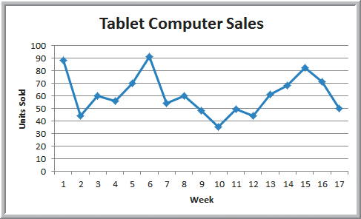
Statistical Forecasting Models
Example 10.5 Moving Average Forecasting
The Tablet Computer Sales data contains the number of units sold over the past 17 weeks.
This time series appears stable without trend, seasonal, or cyclical effects.
Figure 10.4

Slide 15
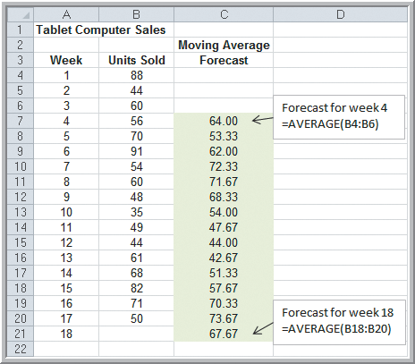
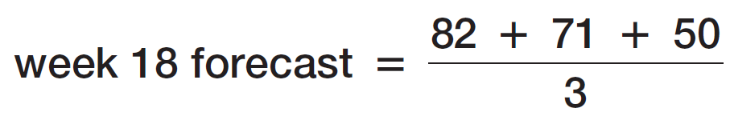
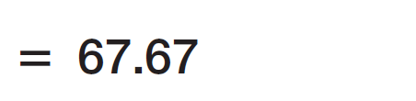
Statistical Forecasting Models
Example 10.5 (continued) Moving Average Forecasting
k = 3 week moving
average forecast
Figure 10.5

Slide 16
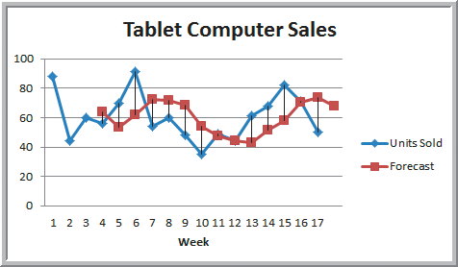
Statistical Forecasting Models
Example 10.5 (continued) Moving Average Forecasting
3 week moving average forecast
Figure 10.6

Slide 17
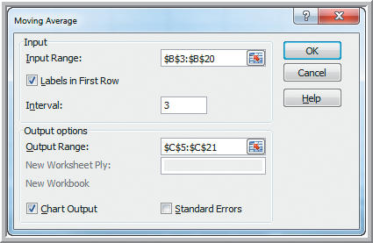
Statistical Forecasting Models
Example 10.6 Using Excel’s Moving Average Tool
3 week moving average
forecast using Excel:
Data Analysis
Moving Average
Input Range: B3:B20
Labels
Interval: 3
Output Range: C5:C21 (1 row down from data itself)
Chart Output (not recommended due to misalignment)
Figure 10.7

Slide 18
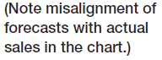
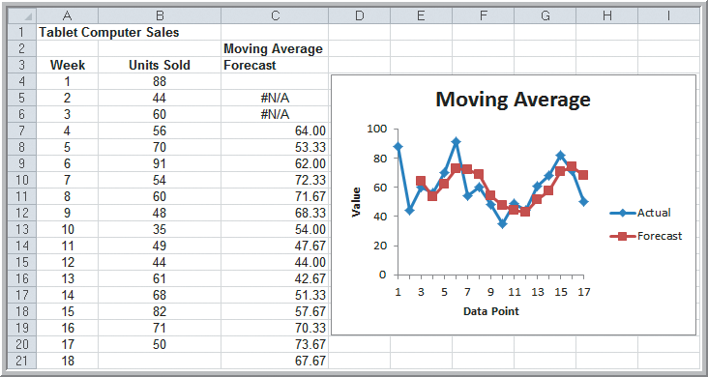
Statistical Forecasting Models
Example 10.6 (continued)
Using Excel’s Moving Average Tool
k = 3
Figure 10.8

Slide 19
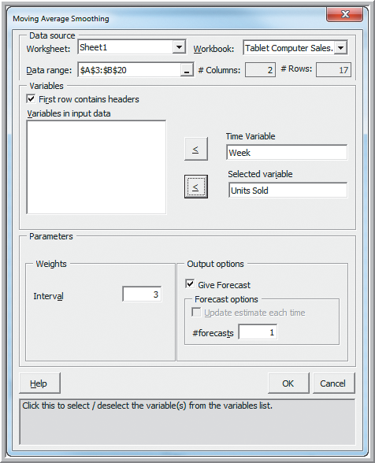
Statistical Forecasting Models
Example 10.7 Moving Average Forecasting
with XLMiner
Add-Ins
XLMiner
Time Series
Smoothing Moving Average
Data Range: A3:B20
Time Variable: Week
Selected Variable: Units Sold
Interval: 3
Figure 10.9

Slide 20
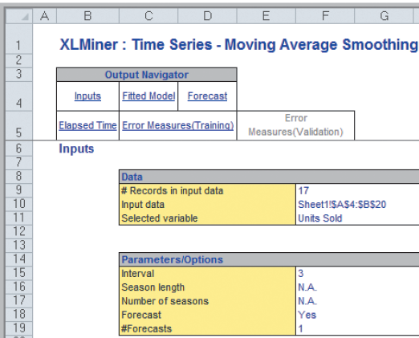
Statistical Forecasting Models
Example 10.7 (continued)
Moving Average Forecasting with XLMiner
Results (Inputs)
Figure 10.10a

Slide 21
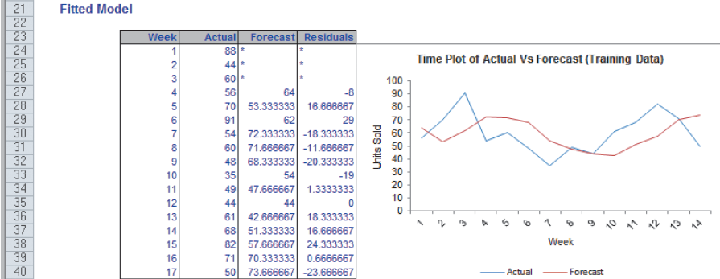
Statistical Forecasting Models
Example 10.7 (continued)
Moving Average Forecasting with XLMiner
Results (Fitted Model)
Correct alignment in chart.
Week 1 plots the first week of
the forecast data at 56 and 64.
Figure 10.10b

Slide 22
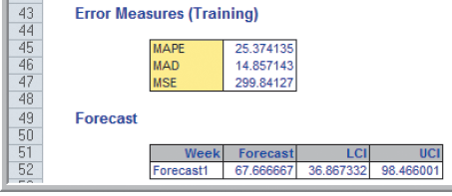
Statistical Forecasting Models
Example 10.7 (continued)
Moving Average Forecasting with XLMiner
Results (Error Measures and Forecast)
Figure 10.10c

Slide 23
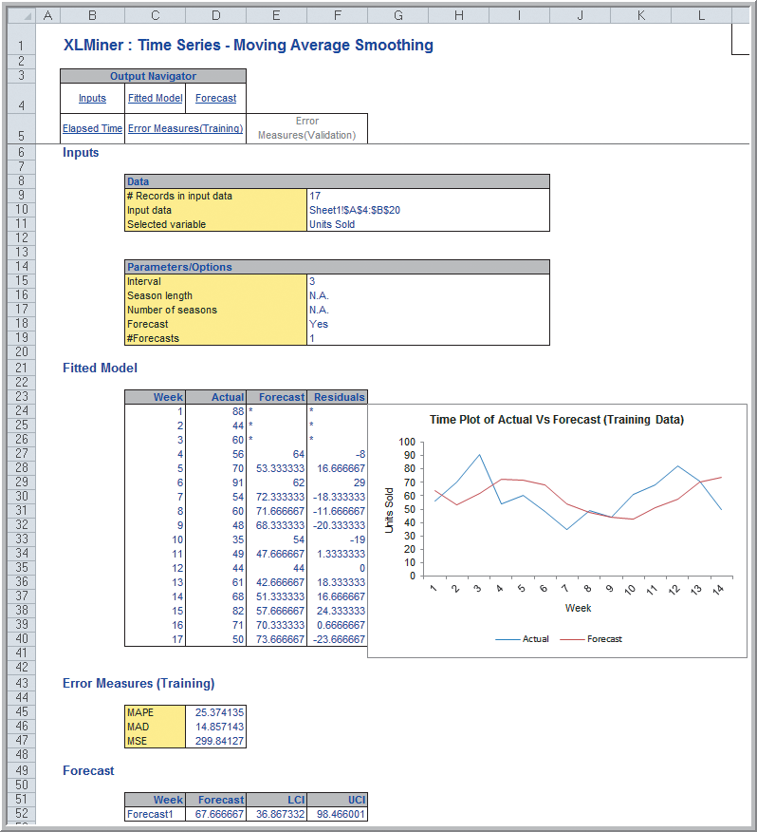
Statistical Forecasting Models
Example 10.7
(continued)
Moving Average
Forecasting with
XLMiner
All sections of the
XLMiner results
Figure 10.10

Slide 24
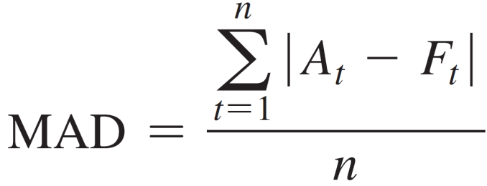
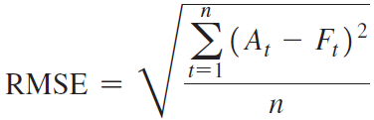
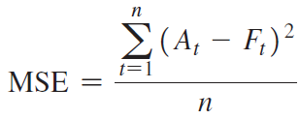
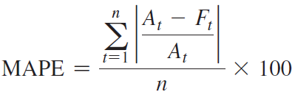
Statistical Forecasting Models
Error Metrics to Compare Forecasts
Below are 4 metrics that can be used to measure the accuracy of forecast models.
Mean Absolute Deviation Root Mean Squared Error
Mean Squared Error Mean absolute % Error

Slide 25
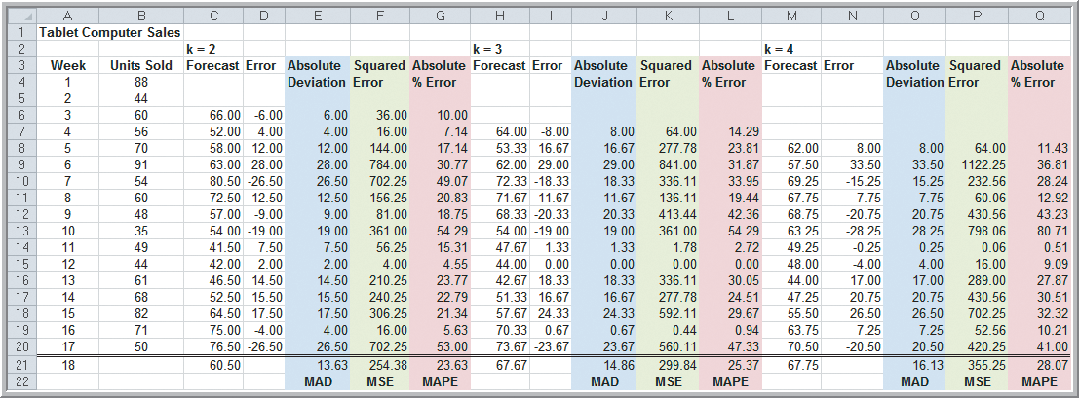
Statistical Forecasting Models
Example 10.8 Using Error Metrics to Compare Moving Average Forecasts
Spreadsheet of MAD, MSE, MAPE for three Tablet Computer Sales forecasting models
Best Model
Figure 10.11

Slide 26
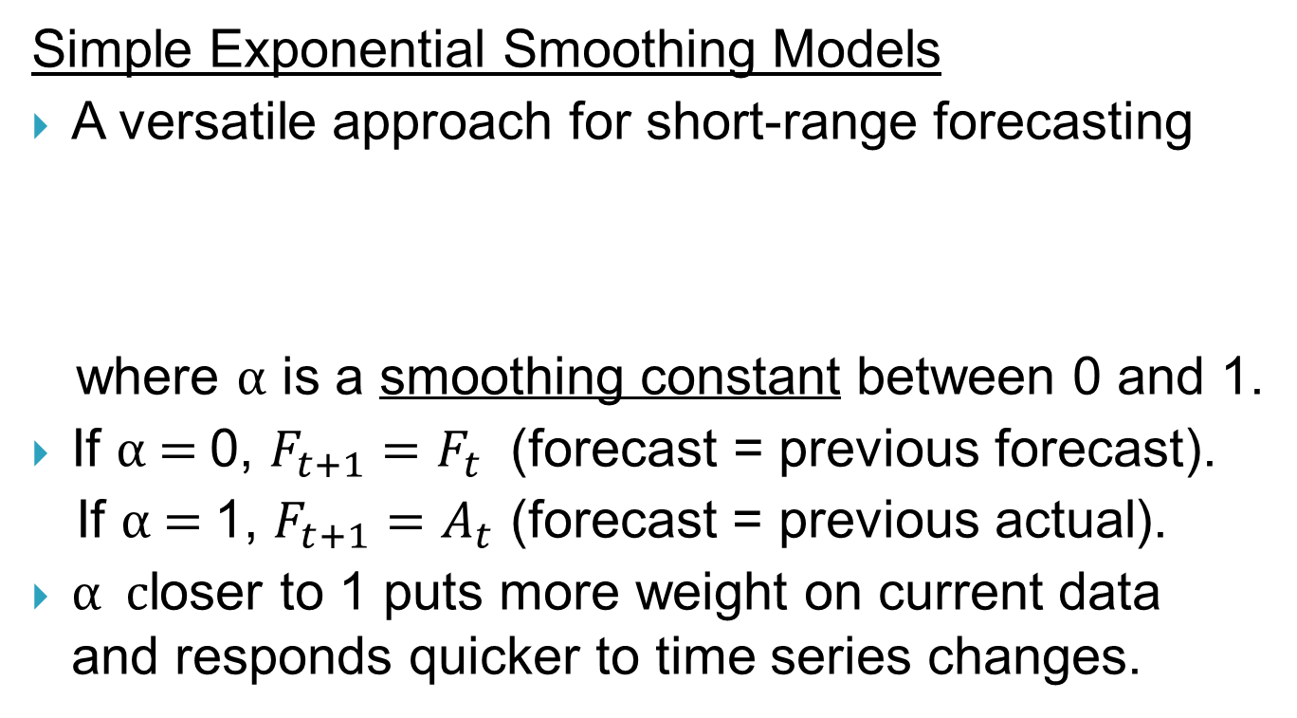
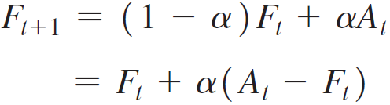
Statistical Forecasting Models

Slide 27
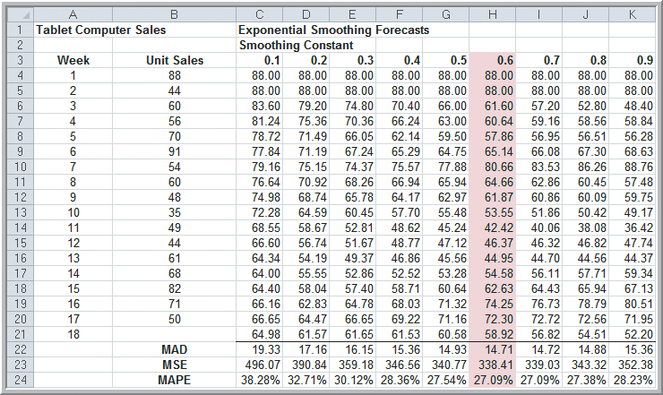
Statistical Forecasting Models
Example 10.9 Using Exponential Smoothing to Forecast Tablet Computer Sales
Figure 10.12
Forecast for week 3 when α = 0.7: (1 – 0.7)(88) + (0.7)(44) = 57.2

Slide 28
Statistical Forecasting Models
Example 10.10 Finding the Best Exponential Smoothing Model for Tablet Computer Sales
Figure 10.12
The forecast using α = 0.6 provides the lowest error metrics.

Slide 29
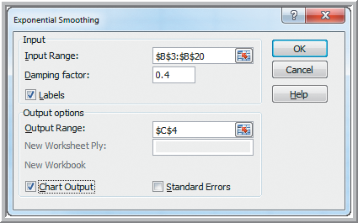
Statistical Forecasting Models
Example 10.11
Using Excel’s Exponential Smoothing Tool
Tablet Computer Sales using α = 0.6
Data Analysis
Exponential Smoothing
Input Range: B3:B20
Damping factor: 1−α
Output Range: C4
Chart Output: Yes
Figure 10.13

Slide 30
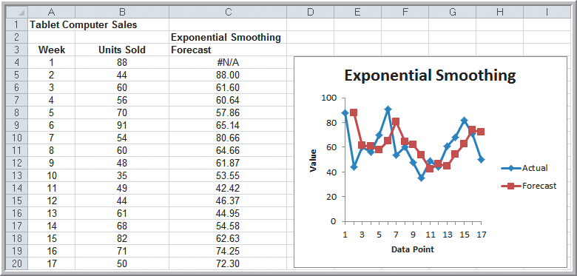
Statistical Forecasting Models
Example 10.11 (continued)
Using Excel’s Exponential Smoothing Tool
Correct alignment in chart.
Figure 10.14

Slide 31
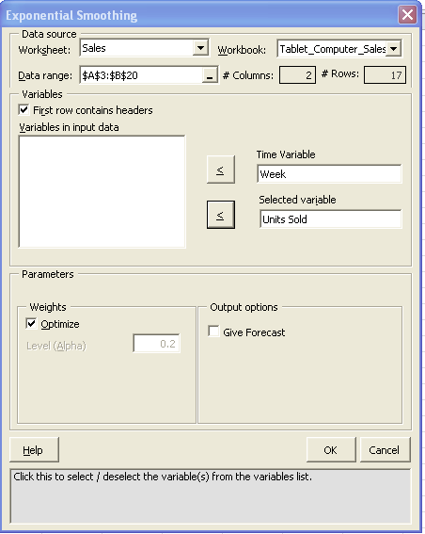
Statistical Forecasting Models
Example 10.12 Optimizing Exponential Smoothing Forecasts Using XLMiner (Tablet Computer Sales)
XLMiner
Time Series
Smoothing
Exponential Smoothing
Data Range: A3:B20
Labels
Time Variable: Week
Selected Var: Units Sold
Weights: Optimize

Slide 32
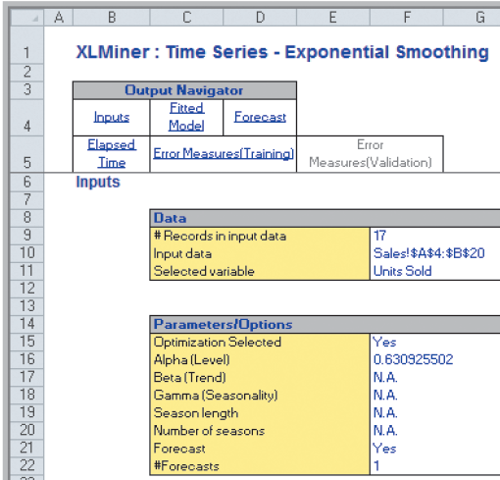
Statistical Forecasting Models
Example 10.12 Optimizing Exponential Smoothing Forecasts Using XLMiner (Tablet Computer Sales)
Input Section of Results
Optimal
α = 0.63
From Figure 10.15

Slide 33
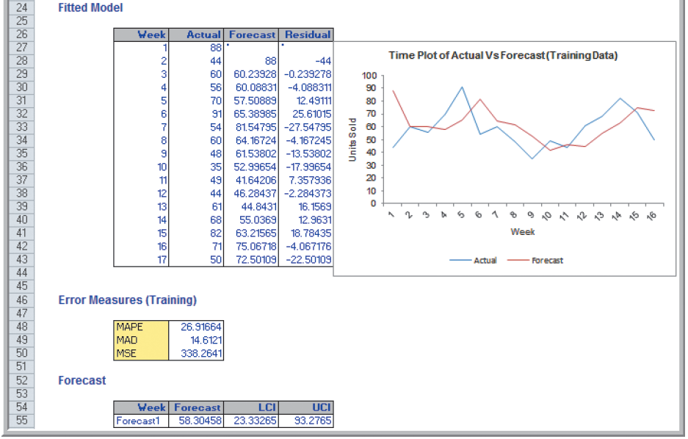
Statistical Forecasting Models
Example 10.12 (continued) Optimizing Exponential Smoothing Forecasts Using XLMiner
From Figure 10.15

Slide 34
Forecasting Models for Time Series with a Linear Trend
Models for Time Series with Linear Trends
1. Double moving average
2. Double exponential smoothing
3. Simple linear regression
The models above are based on the linear trend equation F_{t+k} = a_{t} + b_{t} k
The forecast for k periods into the future is a function of the level a_{t} and the trend b_{t}
The models differ in their computations of a_{t} and b_{t}

Slide 35
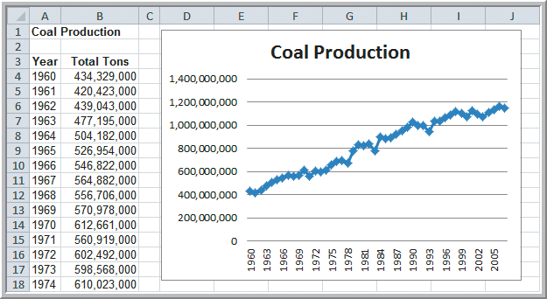
Forecasting Models for Time Series with a Linear Trend
Example 10.13 Double Exponential Smoothing with XLMiner (Coal Production data 1960-2007)
Choose to
optimize
α and β
Figure 10.16

Slide 36
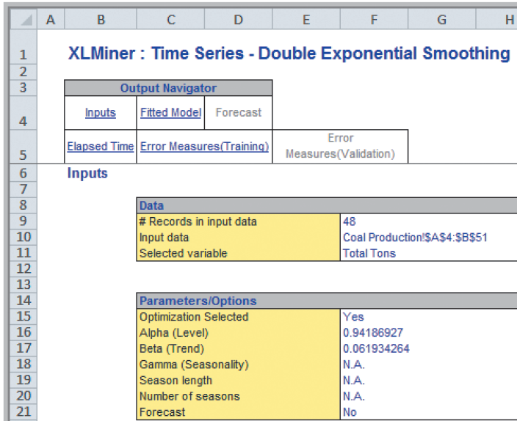
Forecasting Models for Time Series with a Linear Trend
Example 10.13 (continued)
Double Exponential Smoothing with XLMiner
Input section
of Results
α = 0.9419
β = 0.0619
From Figure 10.17

Slide 37
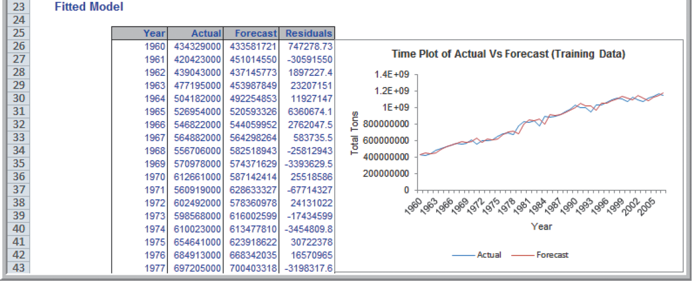
Forecasting Models for Time Series with a Linear Trend
Example 10.13 (continued)
Double Exponential Smoothing with XLMiner
Fitted Model section of results
From Figure 10.17

Slide 38
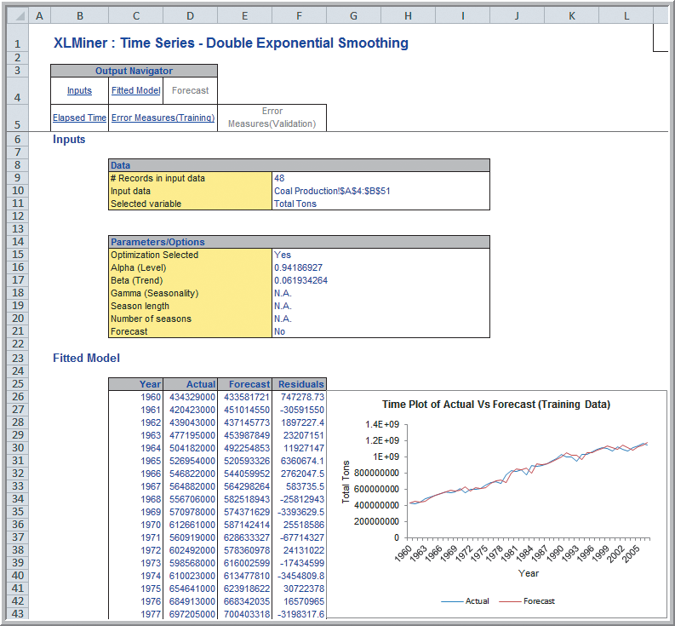
Forecasting Models for Time Series with a Linear Trend
Example 10.13 (continued)
Double Exponential Smoothing with XLMiner
Complete
XLMiner results
Figure 10.17

Slide 39
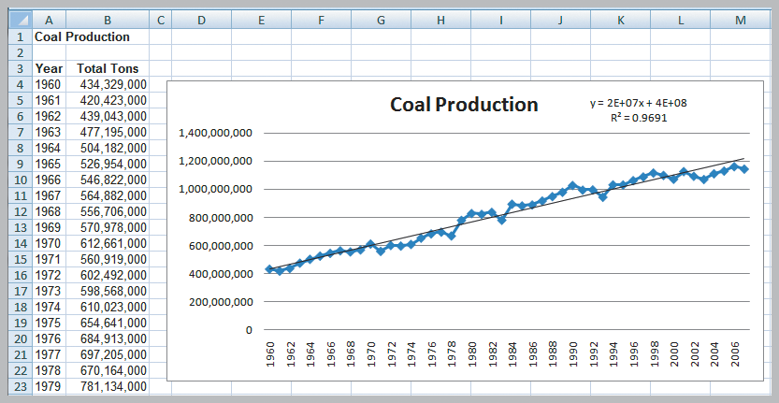
Forecasting Models for Time Series with a Linear Trend
Example 10.14 Forecasting Using Linear Regression (Coal Production data)
Figure 10.18

Slide 40
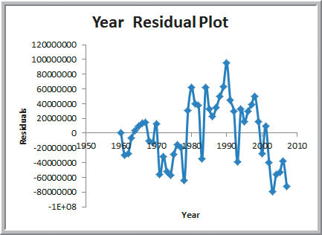
Forecasting Models for Time Series with a Linear Trend
Example 10.14 (continued) Forecasting Using Linear Regression (Coal Production data)
Time series data can violate the regression assumption of independence of errors.
Prepare a residual plot to check for autocorrelation
The residuals do not appear to be random.
Successive observations seem related.
This suggests we have autocorrelation, indicating this regression model is not appropriate for this data.
Figure 10.19

Slide 41
Forecasting Time Series with Seasonality
Forecasting Models with Seasonality
1. Linear Regression using dummy variables
2. Holt-Winters models
a) Additive – stable seasonality
b) Multiplicative – amplitude changes over time
Three parameters are use to smooth the:
level, α
trend, β
seasonality, γ

Slide 42
Forecasting Time Series with Seasonality
Example 10.15 Regression-Based Forecasting for Natural Gas Usage
(Gas & Electric Usage)
Develop a regression-
based forecast for the
monthly gas usage data
using dummy variables.
k = 12 months
Define k – 1 dummy variables.
Use January as the reference month.
Figure 10.2
Figure 10.20

Slide 43
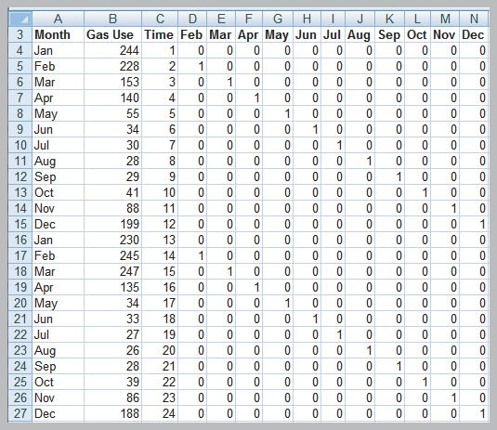
Forecasting Time Series with Seasonality
Example 10.15 (continued) Regression-Based Forecasting for Natural Gas Usage
Y = Gas Use
X₁ = 1 Time
X₂ = 1 if Feb.
X₃ = 1 if March
: : :
X₁₂ = 1 if Dec.
X₁ is for trend
X₂ -X₁₂ seasonality
Figure 10.20

Slide 44
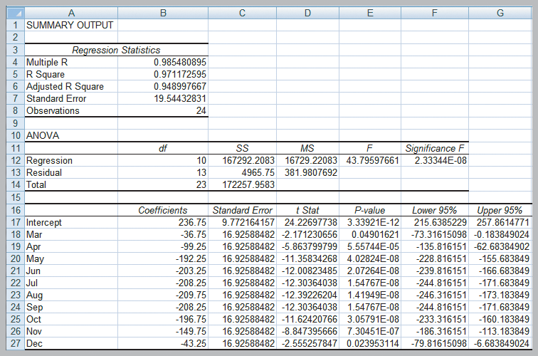
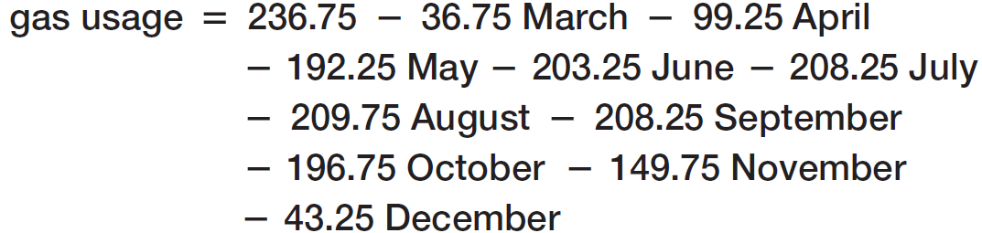
Forecasting Time Series with Seasonality
Example 10.15 (continued)
After removing insignificant Time and February variables:
Figure 10.21

Slide 45
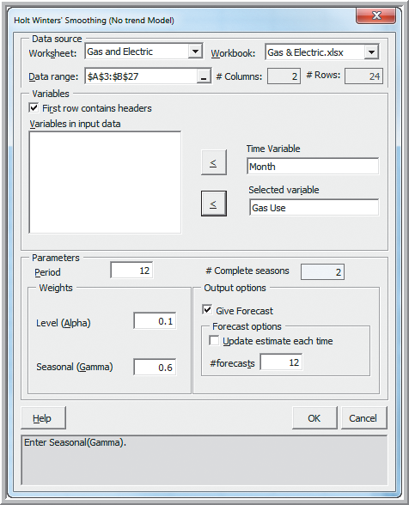
Forecasting Time Series with Seasonality
Example 10.16 Forecasting Natural Gas Usage Using Holt-Winters No-Trend Model
XLMiner
Time Series
Smoothing
Holt Winter No Trend…
Data Range: A3:B27
Time Variable: Month
Selected Variable: Gas Use
Period: 12
Level (Alpha): 0.1
Seasonal (Gamma): 0.6
Figure 10.22

Slide 46
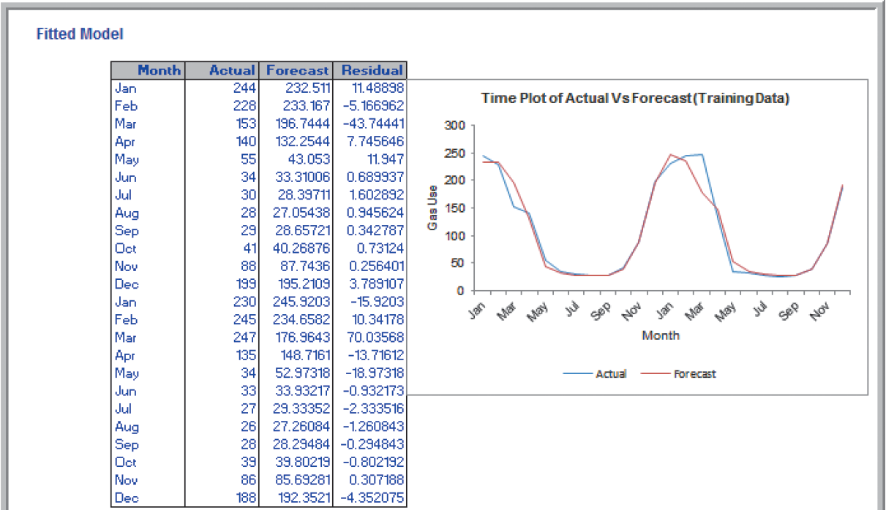
Forecasting Time Series with Seasonality
Example 10.16 (continued) Forecasting Natural Gas Usage Using Holt-Winters No-Trend Model
From Figure 10.23

Slide 47
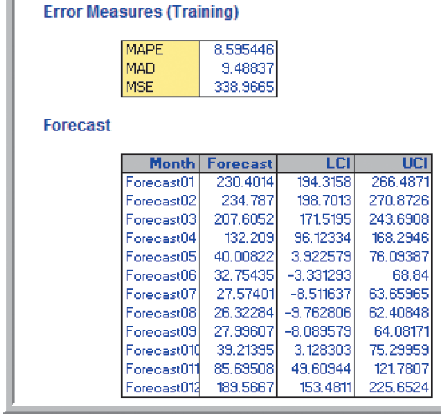
Forecasting Time Series with Seasonality
Example 10.16 (continued) Forecasting Natural Gas Usage Using Holt-Winters No-Trend Model
Results for α = 0.1 and γ = 0.6.
Point estimates and confidence intervals are provided.
From Figure 10.23

Slide 48
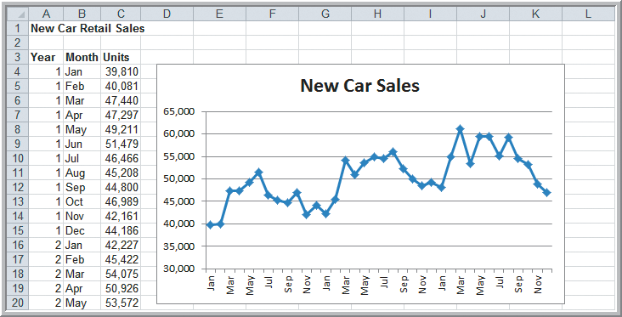
Forecasting Time Series with Seasonality
Example 10.17 Forecasting New Car Sales Using Holt-Winters Models
Data reveals both a trend and a seasonal effect.
Since seasonality is stable, use an Additive model.
Figure 10.24

Slide 49
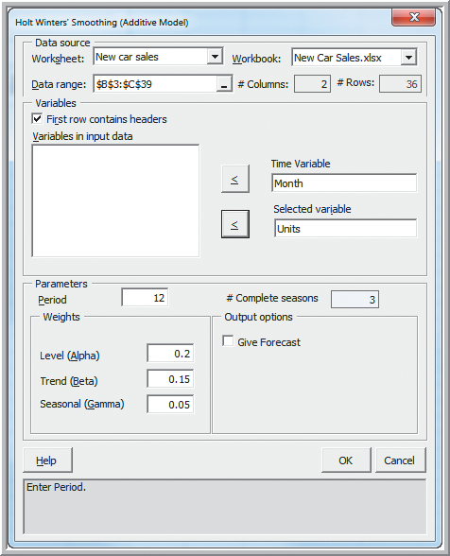
Forecasting Time Series with Seasonality
Example 10.17 (continued) Forecasting New Car Sales Using Holt-Winters Models
XLMiner > Time Series
Smoothing
Holt Winter
Additive…
Data Range: B3:C29
Time Variable: Month
Selected Variable: Units
Period: 12
Level (Alpha): 0.2
Trend (Beta): 0.15
Seasonal (Gamma): 0.05
Figure 10.25

Slide 50
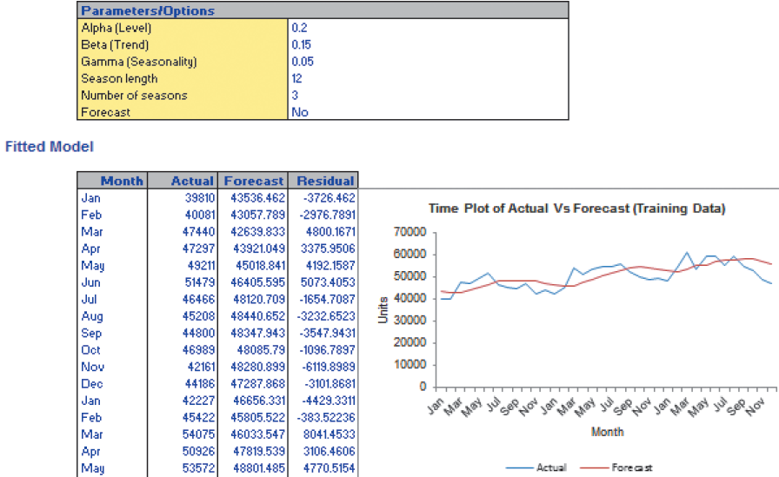
Forecasting Time Series with Seasonality
Example 10.17 (continued) Forecasting New Car Sales Using Holt-Winters Models
Figure 10.26

Slide 51
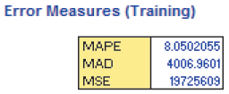
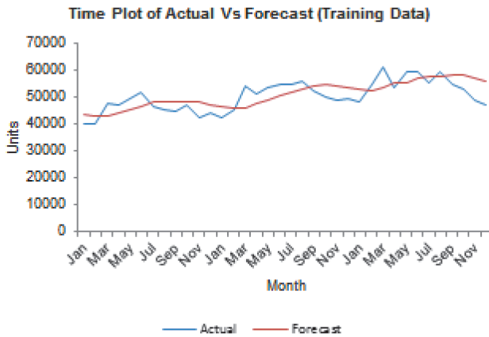
Forecasting Time Series with Seasonality
Example 10.17 (continued) Forecasting New Car Sales Using Holt-Winters Models
α = 0.20, β = 0.15 and γ = 0.05
Forecasts do not track the data very well, possibly due to the choice of the seasonal factor γ.
The Holt-Winter’s models in XLMiner do not optimize the values of α, β, and γ.
From Figure 10.26

Slide 52
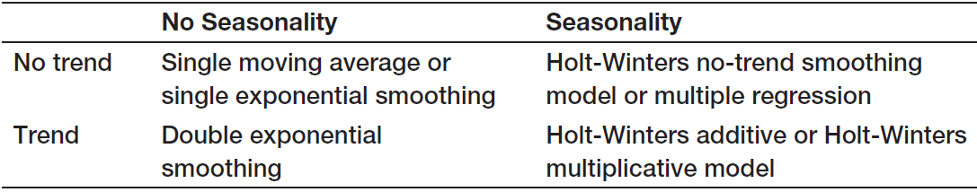
Selecting Appropriate Time-Series-Based Forecasting Methods
Forecasting Models Available in XLMiner
Parameters required:
Specify k for the single moving average model
Specify optimize (or α) for single exponential
Specify optimize (or α, β) for double exponential
Specify α, γ for Holt-Winters no-trend models
Specify α, β, γ for Holt-Winters trend models
Table 10.1

Slide 53
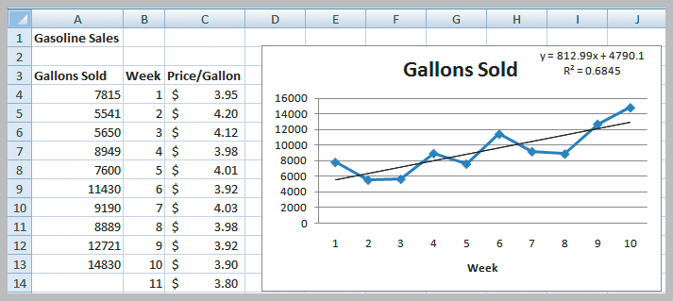
Regression Forecasting with Causal Variables
Example 10.18 Forecasting Gasoline Sales Using Simple Linear Regression
Figure 10.27
Predicted sales for week 11 = 812.99(11) + 4790.1 = 13,733 gallons

Slide 54
Regression Forecasting with Causal Variables
Example 10.19 Incorporating Causal Variables in a Regression-Based Forecasting Model
Develop a multiple linear regression model to predict gasoline sales using both time and price per gallon.
Price per gallon is a causal variable.
Causal or explanatory variables are those that may influence the time series.
Econometric models include both time and causal variables.

Slide 55
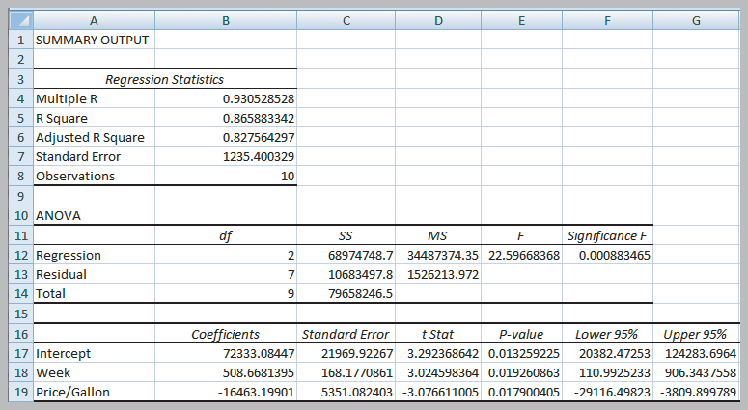
Regression Forecasting with Causal Variables
Example 10.19 (continued) Gasoline Sales data
Predicted sales for week 11
= 72,333 + 508.7(11) − 16,463(3.80)
= 15,368 gallons
Figure 10.28

Slide 56
The Practice of Forecasting
Forecasting Use in Practice
Judgmental and Qualitative methods are used for forecasting sales of product lines and broad company and industry forecasts.
Simple time-series models are used for short- and medium-range forecasts.
Regression methods are typically used for long-term forecasts.

Slide 57

The Practice of Forecasting
Analytics in Practice:
Forecasting at NBC Universal
NBCU has a difficult task of forecasting market demand for television programming.
Time series models used by NBCU incorporate the Delphi method and “grass-roots forecasting.”
Their time series market demand forecasts are used to price television advertisement deals, often worth more than a billion dollars.

Slide 58
Chapter 10 - Key Terms
Cyclical effect
Delphi method
Double exponential smoothing
Double moving average
Econometric model
Historical analogy
Holt-Winters additive model
Holt-Winters models
Holt-Winters multiplicative model
Index
Indicator
Mean absolute deviation (MAD)
Mean absolute percentage error (MAPE)
Mean square error (MSE)
Root mean square error (RMSE)

Slide 59
Chapter 10 - Key Terms (continued)
Seasonal effect
Simple exponential smoothing
Simple moving average
Smoothing constant
Stationary time series
Time series
Trend

Slide 60
Case Study Performance Lawn Equipment (10)
Recall that PLE produces lawnmowers and a medium size diesel power lawn tractor.
Forecast sales of mowers and tractors in each marketing region.
Forecast industry sales in order to assess future changes in market share.
Forecast future increases in production costs.
Develop forecasting models for each of the above and write a formal report summarizing your results.

Slide 61


